Slide 1
INTELLIGENT AGENT
BY DR. KAJAL NUSRATULLAH

Slide 2
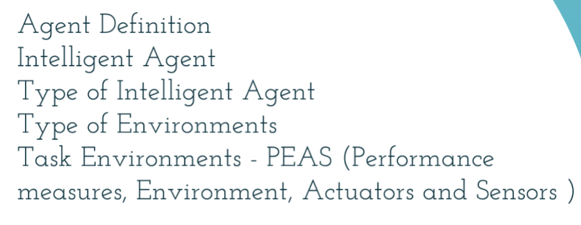
OUTLINES

Slide 3
AGENT & INTELLIGENT AGENT
AGENT:
An agent can be anything that perceive its environment through sensors and act upon that environment through actuators.
An Agent runs in the cycle of perceiving, thinking, and acting.
INTELLIGENT AGENT:
An intelligent agent is a program that can make decisions or perform a service based on its environment, user input and experiences.
These programs can be used to autonomously gather information on a regular, programmed schedule or when prompted by the user in real time.

Slide 4
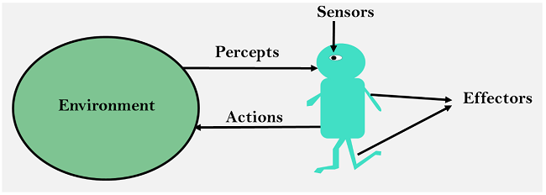
COMPONENTS OF AN AGENT
Sensor: Sensor is a device which detects the change in the environment and sends the information to other electronic devices. An agent observes its environment through sensors.
Actuators: Actuators are the component of machines that converts energy into motion. The actuators are only responsible for moving and controlling a system. An actuator can be an electric motor, gears, rails, etc.
Effectors: Effectors are the devices which affect the environment. Effectors can be legs, wheels, arms, fingers, wings, fins, and display screen.

Slide 5
The structure of an intelligent agent is a combination of architecture and agent program. It can be viewed as:
Agent = Architecture + Agent program
Architecture: Architecture is machinery that an AI agent executes on.
Agent function: Agent function is used to map a percept to an action.
Agent program: Agent program is an implementation of agent function. An agent program executes on the physical architecture to produce function f.
Structure of an
AI Agent

Slide 6
AGENT & INTELLIGENT AGENT
An agent can be:
Robotic Agent: A robotic agent can have cameras, infrared range finder, NLP for sensors and various motors for actuators.
Software Agent: Software agent can have keystrokes, file contents as sensory input and act on those inputs and display output on the screen..

Slide 7
Rules for an AI agent
Rule 1: An AI agent must have the ability to perceive the environment.
Rule 2: The observation must be used to make decisions.
Rule 3: Decision should result in an action.
Rule 4: The action taken by an AI agent must be a rational action.

Slide 8
RATIONALITY
Rationality is an important factor in an AI agent.
A rational agent is an agent which has clear preference, models uncertainty, and acts in a way to maximize its performance measure with all possible actions.
The rational agent considers all possibilities and chooses to perform the highly efficient action. For example it chooses the shortest path with low cost for high efficiency.
The rationality of an agent is measured by its performance measure. Rationality can be judged on the basis of following points:
Performance measure which defines the success criterion.
Agent prior knowledge of its environment.
Best possible actions that an agent can perform.
The sequence of percepts.

Slide 9
PEAS
PEAS stands for Performance measure, Environment, Actuator, Sensor.
Performance Measure: Performance measure is the unit to define the success of an agent.Performance varies with agents based on their different precept.
Environment: Environment is the surrounding of an agent at every instant. It keeps changing with time if the agent is set in motion. There are 5 major types of environments:
Fully Observable & Partially Observable
Episodic & Sequential
Static & Dynamic
Discrete & Continuous
Deterministic & Stochastic
Actuator: Actuator is a part of the agent that delivers the output of an action to the environment.
Sensor: Sensors are the receptive parts of an agent which takes in the input for the agent.

Slide 10
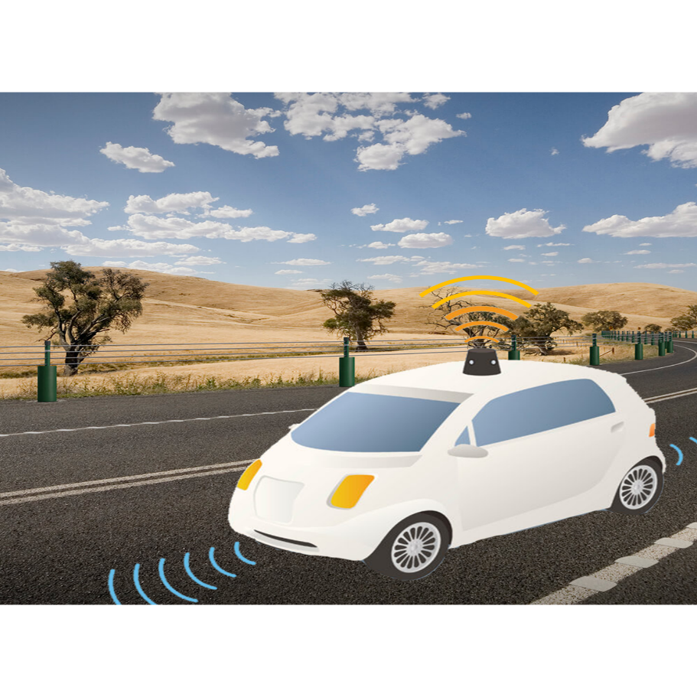
PEAS for self-driving cars
Let's suppose a self-driving car then PEAS representation will be:
Performance: Safety, time, legal drive, comfort
Environment: Roads, other vehicles, road signs, pedestrian
Actuators: Steering, accelerator, brake, signal, horn
Sensors: Camera, GPS, speedometer, odometer, accelerometer, sonar.

Slide 11
Example of Agents with their
PEAS representation

Slide 12
PEAS Representation
Agent | Performance measure | Environment | Actuators | Sensors
Medical Diagnose | Healthy patient Minimized cost | Patient Hospital Staff | Tests Treatments | Keyboard (Entry of symptoms)
Vacuum Cleaner | Cleanness Efficiency Battery life Security | Room Table Wood floor Carpet Various obstacles | Wheels Brushes Vacuum Extractor | Camera Dirt detection sensor Cliff sensor Bump Sensor Infrared Wall Sensor
Part -picking Robot | Percentage of parts in correct bins. | Conveyor belt with parts, Bins | Jointed Arms Hand | Camera Joint angle sensors.

Slide 13
PEAS Representation
Agent | Performance Measure | Environment | Actuator | Sensor
Hospital Management System | Patient’s health, Admission process, Payment | Hospital, Doctors, Patients | Prescription, Diagnosis, Scan report | Symptoms, Patient’s response
Automated Car Drive | Comfortable trip, Safety, Maximum Distance | Roads, Traffic, Vehicles | Steering wheel, Accelerator, Brake, Mirror | Camera, GPS, Odometer
Subject Tutoring | Maximize scores, Improvement is students | Classroom, Desk, Chair, Board, Staff, Students | Smart displays, Corrections | Eyes, Ears, Notebooks

Slide 14
Types of Environments in AI

Slide 15
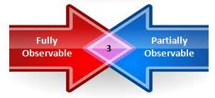
Fully Observable vs Partially Observable
When an agent sensor is capable to sense or access the complete state of an agent at each point in time, it is said to be a fully observable environment else it is partially observable.
Maintaining a fully observable environment is easy as there is no need to keep track of the history of the surrounding.
An environment is called unobservable when the agent has no sensors in all environments.
Example:
Chess – the board is fully observable, so are the opponent’s moves
Driving – the environment is partially observable because what’s around the corner is not know.

Slide 16
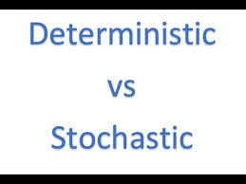
Deterministic vs Stochastic
When a uniqueness in the agent’s current state completely determines the next state of the agent, the environment is said to be deterministic.
The stochastic environment is random in nature which is not unique and cannot be completely determined by the agent.
Example: Chess – there would be only a few possible moves for a coin at the current state and these moves can be determined Self Driving Cars – the actions of a self-driving car are not unique, it varies time to time

Slide 17

Competitive vs Collaborative
An agent is said to be in a competitive environment when it competes against another agent to optimize the output.
The game of chess is competitive as the agents compete with each other to win the game which is the output.
An agent is said to be in a collaborative environment when multiple agents cooperate to produce the desired output.
When multiple self-driving cars are found on the roads, they cooperate with each other to avoid collisions and reach their destination which is the output desired.

Slide 18
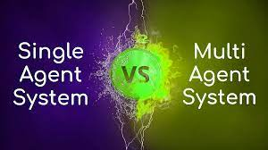
Single-agent vs Multi-agent
An environment consisting of only one agent is said to be a single-agent environment.
A person left alone in a maze is an example of the single-agent system.
An environment involving more than one agent is a multi-agent environment.
The game of football is multi-agent as it involves 11 players in each team.

Slide 19

Dynamic vs Static
An environment that keeps constantly changing itself when the agent is up with some action is said to be dynamic.
A roller coaster ride is dynamic as it is set in motion and the environment keeps changing every instant.
An idle environment with no change in its state is called a static environment.
An empty house is static as there’s no change in the surroundings when an agent enters.

Slide 20
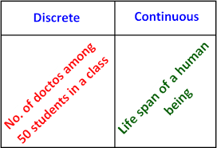
Discrete vs Continuous
If an environment consists of a finite number of actions that can be deliberated in the environment to obtain the output, it is said to be a discrete environment.
The game of chess is discrete as it has only a finite number of moves. The number of moves might vary with every game, but still, it’s finite.
The environment in which the actions performed cannot be numbered i.e. is not discrete, is said to be continuous.
Self-driving cars are an example of continuous environments as their actions are driving, parking, etc. which cannot be numbered.

Slide 21
Types of AI Agents
Agents can be grouped into five classes based on their degree of perceived intelligence and capability. All these agents can improve their performance and generate better action over the time.
These are given below:
Simple Reflex Agent
Model-based reflex agent
Goal-based agents
Utility-based agent
Learning agent

Slide 22
Simple Reflex Agent
The Simple reflex agents are the simplest agents. These agents take decisions on the basis of the current percepts and ignore the rest of the percept history.
These agents only succeed in the fully observable environment.
The Simple reflex agent does not consider any part of percepts history during their decision and action process.
The Simple reflex agent works on Condition-action rule, which means it maps the current state to action. Such as a Room Cleaner agent, it works only if there is dirt in the room.
Problems for the simple reflex agent design approach:
They have very limited intelligence
They do not have knowledge of non-perceptual parts of the current state
Mostly too big to generate and to store.
Not adaptive to changes in the environment.
The agent has no memory.

Slide 23
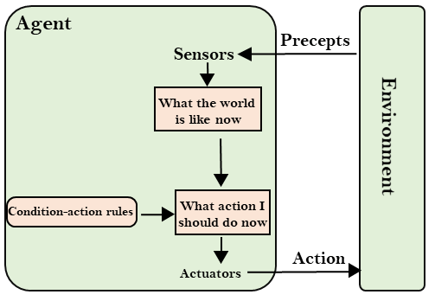
Simple Reflex Agent

Slide 24
Model-based Reflex Agent
The Model-based agent can work in a partially observable environment, and track the situation.
A model-based agent has two important factors:
Model: It is knowledge about "how things happen in the world," so it is called a Model-based agent.
Internal State: It is a representation of the current state based on percept history.
These agents have the model, "which is knowledge of the world" and based on the model they perform actions.
Updating the agent state requires information about:
How the world evolves
How the agent's action affects the world.

Slide 25
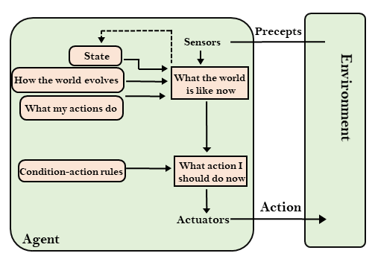
Model-based Reflex Agent

Slide 26
Goal-based Agents
The knowledge of the current state environment is not always sufficient to decide for an agent to what to do.
The agent needs to know its goal which describes desirable situations.
Goal-based agents expand the capabilities of the model-based agent by having the "goal" information.
They choose an action, so that they can achieve the goal.
These agents may have to consider a long sequence of possible actions before deciding whether the goal is achieved or not. Such considerations of different scenario are called searching and planning, which makes an agent proactive.

Slide 27
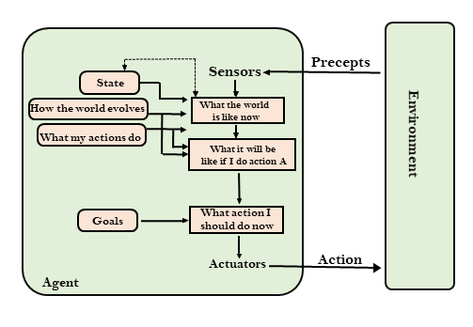
Goal-based Agents

Slide 28
Utility-based agents
These agents are similar to the goal-based agent but provide an extra component of utility measurement which makes them different by providing a measure of success at a given state.
Utility-based agent act based not only goals but also the best way to achieve the goal.
The Utility-based agent is useful when there are multiple possible alternatives, and an agent has to choose in order to perform the best action.
The utility function maps each state to a real number to check how efficiently each action achieves the goals.

Slide 29
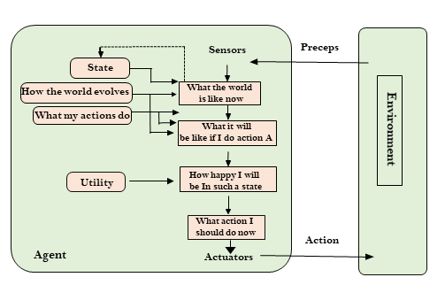
Utility-based agents

Slide 30
Learning Agents
A learning agent in AI is the type of agent which can learn from its past experiences, or it has learning capabilities.
It starts to act with basic knowledge and then able to act and adapt automatically through learning.
A learning agent has mainly four conceptual components, which are:
Learning element: It is responsible for making improvements by learning from environment
Critic: Learning element takes feedback from critic which describes that how well the agent is doing with respect to a fixed performance standard.
Performance element: It is responsible for selecting external action
Problem generator: This component is responsible for suggesting actions that will lead to new and informative experiences.
Hence, learning agents are able to learn, analyze performance, and look for new ways to improve the performance.

Slide 31
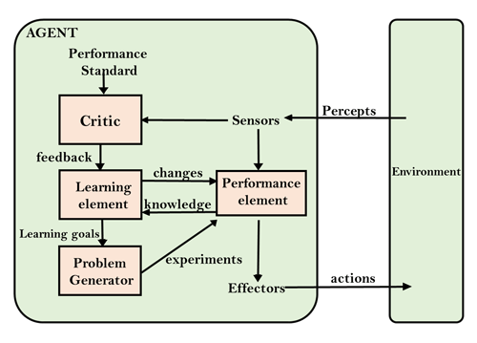
Learning Agents

